Slide 1
EASTER IN SLOVENIA
BY: Ajda Vozelj, Tadeja Rozman and Hana Zakšek Lamovšek

Slide 2
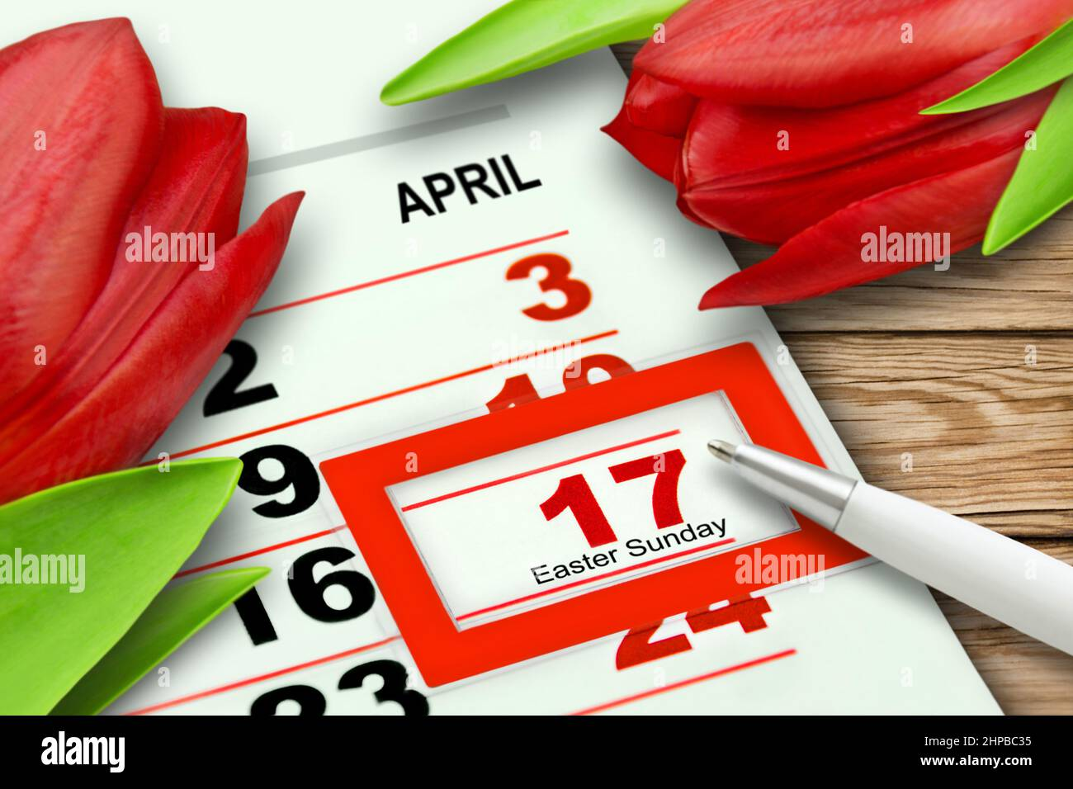
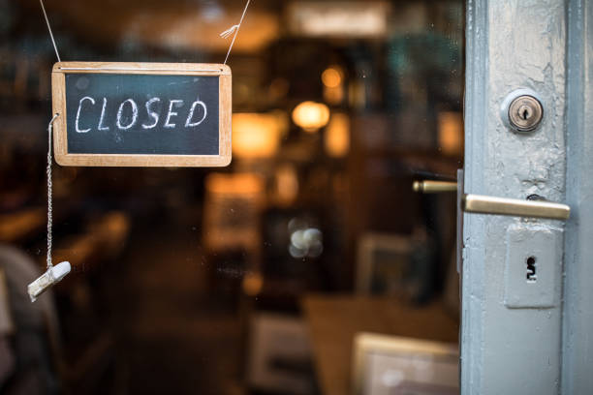
WHEN DO WE CELEBRATE EASTER
We celebrate easter on 17th april which is in 4 days. We also have easter Monday, which means that we don‘t go to school or job. The stores are closed both days.

Slide 3
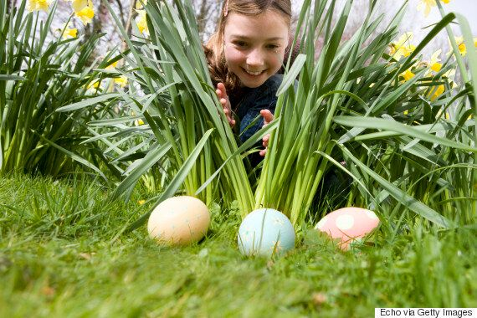
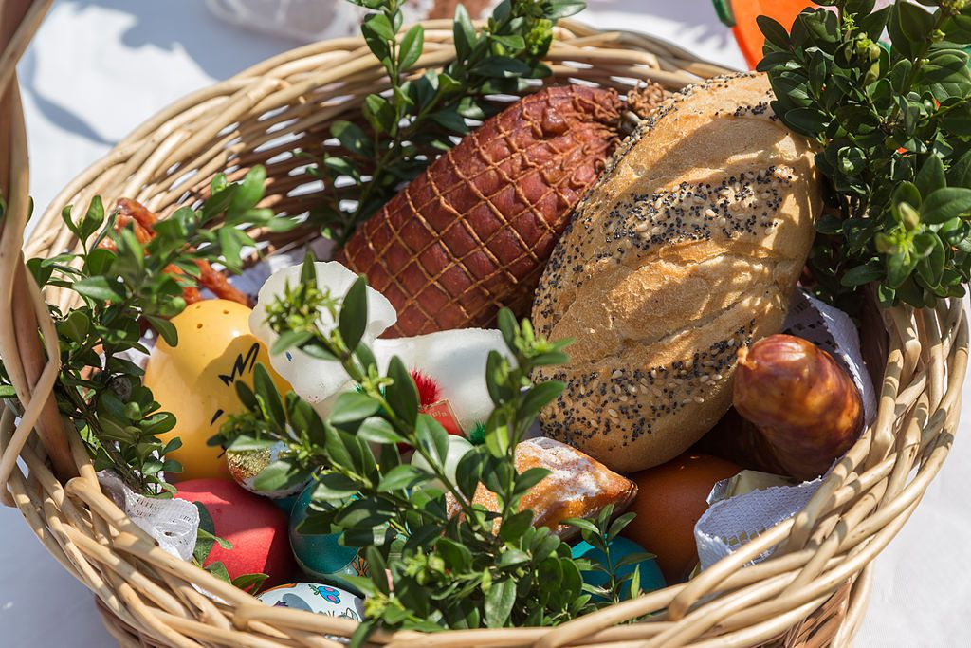
WHAT WE DO ON EASTER
We go to church on Saturday in the very morning to bless painted eggs, ham and horse radish. Then we eat the food.
On Sunday we go to church again and then we meet up with friends and family. We hide the easter eggs so children try to find them.

Slide 4
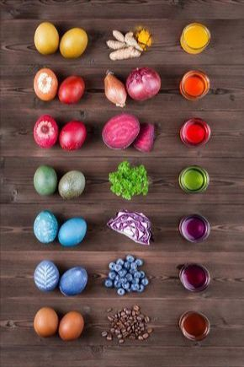
HOW WE COLOUR EASTER EGGS
We colour them in natural colour. We usually colour them, with onion peels, spinach or something else. At first they are very pale but soon they become more vibrant.

Slide 5
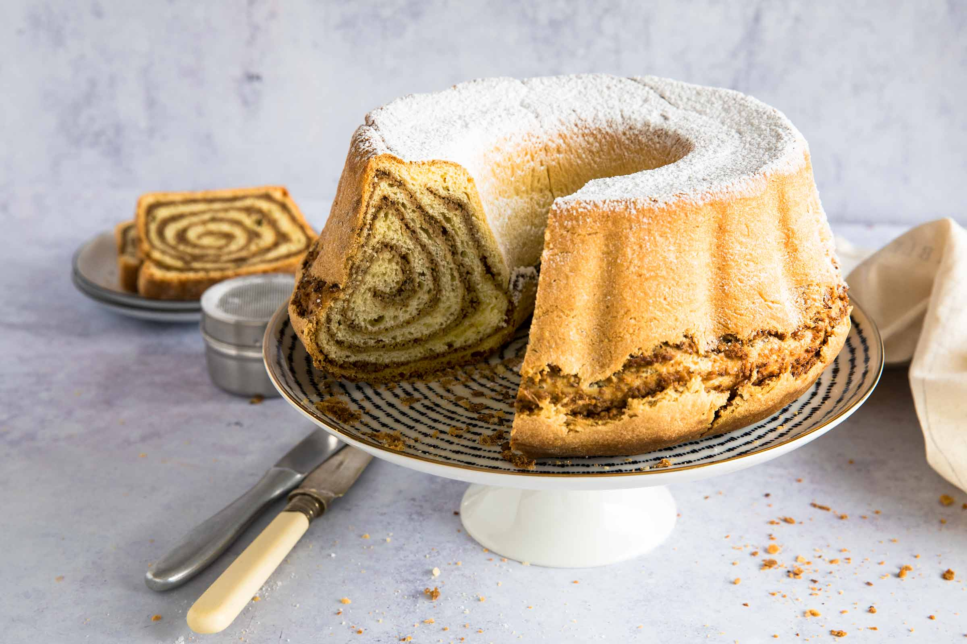
RECIPE for WALNUT ROLL
Dough:
Flour 600 g
Salt 0.5 tsp
Yeast 1 piece
Sugar 40 g
Butter 75 g
Milk 3 dl
Lemon peel 1 piece
Yolk 3 pieces
Rum 0.5 dl
For the filling :
Ground walnuts 500 g
Vanilla stick 1 piece
Butter 100 g
Sugar 200 g
Milk 2 dl
Eggs 2 pieces
Rum 1 dl

Slide 6
HOW TO MAKE IT
Dough:
1 The yeast is dissolved in warm milk to which rum is added. Mix flour, salt and sugar. Add the melted butter, smooth the yolks and lemon zest, and slowly start to knead.
2 Gradually add the milk and knead a smooth soft dough that does not stick to us. Knead it for about 1 hour and a half.
Stuffing:
1 First, dissolve the butter and sugar in milk, and add vanilla stick, scraping the core. When everything is dissolved together, add rum and walnuts. Let it simmer a bit and then set aside, and add the eggs. Stir the eggs intensively so that the egg does not crack.
2 Roll out the dough on a tablecloth, spread it evenly with the filling and wrap it. We place it in a well-greased baker and let it rise covered again, but this time only for three quarters of an hour. Coat the top with melted butter and bake at 180 degrees for about 1 hour.
3 When the walnut roll has cooled down a bit, turn it out of the pan and sprinkle
with powder sugar.

Slide 7
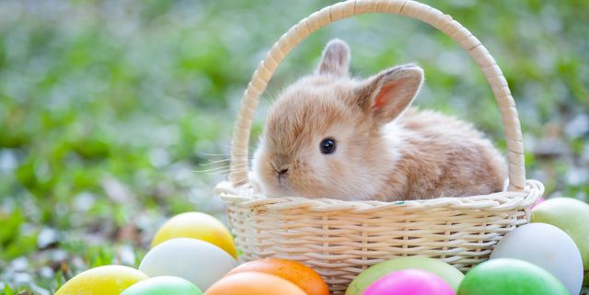
Happy easter!

